Slide 1
DO NOT SHOW
Microsoft Cloud Adoption Framework for Azure Overview
Speaker:
Microsoft Partner
Speaker:
Primary Audience:
ITDM, BDM, Cloud Architect
Audience:
Impacted Audience:
Level:
Foundational (100)
Usage guide:
Usage guide:
This presentation is designed to provide a brief introduction to the Cloud Adoption Framework for Azure. Please tailor to fit your customers needs.
Additional supporting materials:
Documentation https://aka.ms/adopt/overview
Microsoft Assessments https://aka.ms/adopt/assess
MS Learn module Cloud Adoption Framework Learn module

Slide 2

Cloud Adoption Framework for Azure | Overview
Speaker
Title
Notes:
Welcome slide

Slide 3
Agenda
● Why is cloud adoption important?
● Overview: Microsoft Cloud Adoption Framework for Azure
● Overcoming common blockers
● Tools, templates, and assessments

Slide 4
Why is cloud adoption important?

Slide 5
Digital transformation
91%
68%
say digital transformation is increasing profits
of business leaders see digital transformation as a way of sparking innovation and finding efficiencies¹
85%
64%
say they must offer digital services or become irrelevant
say they have less than 4 years to complete a digital transformation or they may go out of business
¹Research Report, ISACA, Information Systems Audit and Control Association, 2018
Notes:
<Key point>: Digital Transformation is the evolution of business
Digital transformation is embracing the necessity of change.
What kind of change are we talking about?
—optimization …
—identifying and implementing efficiencies …
But there is no magic “efficiency” switch to flip. It’s about a process of change—
changing the foundation of how your business works, which we’ll talk about more.
A large percentage of business leaders know if they don’t transform and evolve, their businesses won’t survive.
I’d like to introduce you to Maria.
Maria is the Director of IT in a mid-market clothing company in Brooklyn.
She’s looking for more efficient ways to grow the commerce side of the business—in a globally competitive market.
Maria made a presentation to her leadership team about moving their business to the cloud.
And now, they’ve committed to making this transformation happen.
So, now Maria is putting her best foot forward—making a plan to get there.
But this is uncharted territory for most business leaders, including Maria.
She researched online Help for guidance and soon found herself surrounded by walls of documentation text.
Maria is a quick study, but she had additional questions and clarifications about her specific business case.
She wanted people who could help with fine-tuning technical help—to guide her along the way.
Can any of you relate?
<Transition>: Change is important and necessary in today’s business climate. But changing the way you do business? That’s hard.

Slide 6
Change requires radical thinking.
… but change is difficult.
We understand that.
Change impacts your people, your culture, and feels risky.
It requires leaders to adapt, take risks, and learn quickly.
Change requires a culture shift
within your organization,
and starts with you.
Notes:
<Key point>: change is hard—because it affects people, not just process.
Great. So, now Maria has made the decision to commit to change. And she has leadership on board.
But this is only the first step.
But to walk all this talk we need to take another step. Step by step …
The truth is that Maria’s Brooklyn clothing company is facing increased foreign competition.
And the winds of change are coming. Maria’s marketing colleagues tell her that Greater China has overtaken the US as the largest fashion market in the world in 2020.
She knows that her company needs to become leaner to remain competitive. To stay in business.
The fashion industry was moving to the cloud, innovating, and reaping the profits.
https://customers.microsoft.com/en-us/story/747179-brooks-consumergoods-microsoft365
Maria knows that this kind of change is difficult. As Director of IT, she worries about the back-end that drives the business.
She knows that those concerns are about more than just technology. The company prides itself on making hip, Gen-X threads. In a Brooklyn warehouse.
It has an adequate on-premises datacenter. And that’s worked fine, so far, but the company’s hippest clothing line has taken off. Like rocket high, and the website back-end can’t process the orders.
Maria also knows that adopting the cloud to power her business is more than just swapping out physical servers for virtual machines.
It’s a movement that affects culture company-wide, all her employees, and, of course, all her customers. And it starts with her.
Maria knows that the journey to the cloud is hard. But it’s a road she and all her colleagues need to walk—if their business is to compete and thrive.
<Transition>: For businesses, it’s step-by-step path to transformation—but how do you measure this kind of growth?

Slide 7
Modernization drives measurable ROI
Shifting from on-premises operations to the cloud favors your bottom line
Benefits (Three-Year)
$7.3M
Research findings¹ indicate organizations with Azure-mature tenure (three-years):
experience benefits of $13.1 million over three years versus costs of $2.3 million
benefits add up to a net present value (NPV) of $10.8 million and an ROI of 478%.
$3.0M
$1.9M
$927.1K
Avoided on-premises
Avoided on-premises
Income from new and
Income from new
infrastructure costs
FTE costs
larger online B2C sales
enterprise sales
1Forrester Total Economic Impact™ Study Commissioned By Microsoft, August 2019, The Total Economic Impact™ Of Microsoft Azure IaaS Cost Savings And Business Benefits Enabled By Azure Infrastructure-As-A-Service (IaaS)
Notes:
<Key point>: modernization drives measurable growth for your business.
Maria, now with the buy-in from her leadership team, can lead the way to change, to innovation, to transformation.
What can her business get out of the deal? She combs through the documentation with one pressing question—
“What’s in it for me, my business, and our bottom line?”
Well, it turns out, there are a lot of rewards that come with change. And they are measurable, and data-driven.
That’s music to Maria’s ears. She’d prefer a hybrid cloud solution—modernize some on-prem apps and move others to the cloud.
She can avoid some on-premises hardware costs.
She can allocate less funds to pay for reduced staffing at her on-premises datacenter.
Her company’s new clothing line that’s starting to have peak sales can grow online B2C sales with “cloud-bursting” benefits.
That allows Maria to tap into more computing resources when there’s a peak in demand from the 20-something crowd.
It’s evolution and business-wide change. There’s plenty in the cloud for Maria and her bottom line. And for your company too.
<Transition>: The benefits of modernization are data-driven and measurable. So where do we start the process?

Slide 8
Overview: Microsoft Cloud Adoption Framework for Azure

Slide 9
Achieve balance. Deliver modernization. Deli
Best practices
Templates
People
Process
Technology
Documentation
Tools
Control & Stability
Speed &
Results
Align—business, people and technology strategy.
Achieve—business goals with actionable, efficient, and comprehensive guidance.
Deliver—fast results with control and stability.
Notes:
<Key point>: Change is more than adopting technology. It’s adapting how you do business.
The Microsoft Cloud Adoption Framework for Azure means changing how you do business—not just swapping out technology, but changing your enterprise, the culture behind it, and you too.
We share best practices from our employees, partners, and customers who have already undertaken the cloud journey.
The Cloud Adoption Framework brings together people, process, and technology—a strategy that’s aligned to your business goals.
Quickly—efficiently, and with actionable guidance, it provides guidance for your organization’s agile business transformation.
Leading people through change is difficult. It’s not just the technology that changes. It’s your people and processes too.
We can help guide you through.
<Transition>: How does the Cloud Adoption Framework work for your business?

Slide 10
Plan
An iterative process that supports your business … as it evolves
Govern
Manage
Define strategy
Adopt
Ready
Notes:
<Key point>: An iterative process that supports your business needs.
We can help you on your cloud adoption journey.
We put the experience of employees, partners, and customers to work for you.
We work together with you—to build your plan for cloud adoption.
It starts with your vision.
Crystallize your vision for cloud adoption by working cross-functionally with your finance, marketing, sales, and HR departments.
Work to gain consensus on:
Clear motivations: Why are we adopting the cloud?
Defined business outcomes: What results do we expect to see from adopting the cloud?
Business justification: How will the business measure success?
We work with you to build an actionable cloud adoption plan with strategic (above) and tactical inputs such as defining your workloads and assets, aligning your organization, and readying necessary skills.
This cross-team effort is balanced out by the technical team, who will take this vision and execute technical deployment.
We recommend iterative planning to drive your cloud adoption effort—enabling your technical teams to move incrementally, in phases towards cloud adoption.
<move to the Ready phase to explain another example, to show iterative process, if necessary>
You plan will unite your organization in a cross-team initiative that, together, will forecast, budget, implement, and manage its success.
Our approach is Agile, and we consider security, governance, cost-optimization, and hybrid-cloud awareness by default.
Microsoft will work with you, learning how you do business—and help you adapt.
Your organization is changing—moving towards modernization, with challenging new markets, products, customer engagement.
We can help you get there.
<Transition>: What does a cloud adoption framework look like?

Slide 11
Microsoft Cloud Adoption Framework for Azure
Proven guidance to accelerate your cloud adoption journey
Define strategy
Define business justification and expected outcomes
Plan
Align actionable cloud adoption plan to business outcomes
Ready
Prepare people, process and environment for change
Adopt
Migrate or Innovate
Implement desired changes across IT and business processes
Govern
Comply, control and secure
Manage
Operate and optimize
Notes:
<Key point>: Cloud Adoption Framework—modular phases of adoption.
As your organization evolves, the Cloud Adoption Framework adapts to your business needs.
Each module in the diagram is an iterative phase that advances your business through the complete lifecycle of cloud adoption.
Customers can choose the phase best-suited to their degree of cloud adoption maturity. The Cloud Adoption Framework offers a guiding methodology to cloud adoption, with specific approaches to overcoming common blockers to cloud adoption in each module, such as “Define Strategy,” “Plan,”, etc.
The Cloud Adoption Framework offers the enterprise a modular framework of how to incrementally onboard to the cloud.
Cloud adoption shifts how companies obtain, make use of, and lock down their technology resources.
And—this kind of modular framework flips the model of how enterprises operate:
Transitions organizations to need-based consumption of technology resources
Change from cap-ex (capital expenditure) to op-ex (operating expenditure) model
Cloud model assumes security, governance, cost-optimization, and hybrid cloud by default
Develop a future-ready workforce—developing and deploying cloud skill readiness organization-wide
As an organization progress through the Cloud Adoption Framework, what are the main goals of each methodology of “Define Strategy,” “Plan,” you can focus efforts on?
<Transition>: What tools can support you on your cloud adoption journey?

Slide 12
Overcoming common blockers

Slide 13
Overcoming common blockers
Want to migrate existing workloads (apps, data, VMs) to the cloud
Organize my team to get us moving to the cloud
Cloud Journey Tracker
Want to build new products and services in the cloud
Motivations
Initial Org alignment
Define strategy
expected outcomes
Plan
Ready
Adopt
Migrate or Innovate
Skills learning plan
Getting started
Cloud Adoption Plan
Landing zone Blueprints
Need a clear way to guide our path to the cloud
Need a fast way to configure my Azure environment
Getting started
Our team does not have the skills to adopt the cloud
SMART
Digital transformation? Where do I start?
Governance benchmark
Architecture review
Getting started
Govern
Manage
Don’t know which controls, compliance, security we need in our cloud environment
Need to understand how to operate my cloud environment
Notes:
<Key point>: You can resolve business challenges when you assess your business and find the gaps.
You're thinking about driving your company’s cloud adoption effort forward.
And you're thinking about aligning your company’s cloud adoption effort to your business strategy. That might be reducing costs, or enabling expansion into new markets like Maria.
Where do you begin your cloud journey?
Start with the why—why do you want to move your business to the cloud?
Uncover your business triggers and motivations for this transformation.
[Gap/blocker>customer tension point] How do you assess, identify, and address gaps in business strategy.
[Solution/helping hand>enables customer success] Start off with the Define Strategy module.
[Tool to help cloud journey of customer]
Tools like Cloud Journey Tracker can help you to identify your company’s cloud adoption path.
CJT enables you navigates to the most relevant adoption content efficiently, and detect early adoption blockers.
<REPEAT ABOVE PROCESS FOR EACH CAF MODULE/PHASE/METHODOLOGY>
It’s an incremental, cross-team initiative with your organization’s departments.
Mapping the cloud-based technologies you require to enable and execute your organization’s projected level of cloud transformation is a company-wide initiative—that starts with you.
<Transition>: Ther are a variety of tools, templates and resources designed to accelerate your digital transformation journey. Let’s take a high-level look at them.

Slide 14
Tools, templates, and assessments

Slide 15
Tools, templates, and assessments
Define strategy
Plan
Ready
Adopt
Cloud journey tracker
Business outcome template
Cloud adoption plan generator
Azure DevOps demo generator
Cloud adoption plan template
Azure setup guide
Readiness checklist
Naming and tagging tracking template
Landing zone blueprints
Strategic migration assessment and readiness tool (SMART)
Azure migration guide
Azure innovation guide
Govern
Manage
Governance benchmark
Governance process template
Cost Management process template
Deployment acceleration process template
Identity process template
Resource consistency process template
Security baseline process template
Azure architecture review
Best practices source code
Operations management workbook
aka.ms/adopt/tools-templates
Notes:
<Key point> We have tools, assessments, and other assets to support your cloud adoption journey.
<Transition> Although the tools, templates, and assessments enable you to manage your own journey, not everyone wants to do this alone. Let's talk about how we can help.

Slide 16
Thank You

Slide 17

Appendix: Slide template gallery Customize your presentations with the following slide options
DO NOT SHOW
Notes:
The slide template gallery hosts a variety of slide formats to customize your presentations as you see fit.

Slide 18
Achieve balance. Deliver modernization.
Best practices
Templates
People
Process
Technology
Documentation
Tools
Control & Stability
Speed &
Results
Align—business, people and technology strategy.
Achieve—business goals with actionable, efficient, and comprehensive guidance.
Deliver—fast results with control and stability.
Notes:
<Key point>: Change is more than adopting technology. It’s adapting how you do business.
The Microsoft Cloud Adoption Framework for Azure means changing how you do business—not just swapping out technology, but changing your enterprise, the culture behind it, and you too.
We share best practices from our employees, partners, and customers who have already undertaken the cloud journey.
The Cloud Adoption Framework brings together people, process, and technology—a strategy that’s aligned to your business goals.
Quickly—efficiently, and with actionable guidance, it provides guidance for your organization’s agile business transformation.
We take you to the cloud—with security, governance, and cost optimization controls first in mind.
Leading people through change is difficult. It’s not just the technology that changes. It’s your people and processes too.
We can help guide you through.
<Transition>: How does the Cloud Adoption Framework work for your business?

Slide 19
Cloud Adoption Framework
Define Strategy
● Understand motivations ● Business outcomes ● Business justification ● Prioritize project
Plan
● Rationalize digital assets ● Initial organization alignment ● Skills readiness plan ● Cloud adoption plan
Ready
● Azure setup guide ● First landing zone ● Expand the landing zone ● Best practice Validation
Adopt
→ Migrate
● Migration Guide
● First workload migration ● Expanded scenarios ● Best practice validation
● Process improvements
→ Innovate
● Innovation guide ● Expanded scenarios ● Best practice validation ● Process improvements
Govern
● Methodology ● Benchmark initial best practice ● Governance maturity
Manage
● Business commitments ● Operations baseline ● Operations maturity
Plan
Govern
Manage
Define strategy
Adopt
Ready
Notes:
Key point: The phases. The evolution.
Don’t worry, we won’t go into ‘datasheet mode,’ but there is value in looking at a little more detail of how this process is designed to help you.
This might seem overwhelming.
We (and our partners) are here to help.
With the Cloud Adoption Framework, you are not alone.
Also, this is modular. Take a step, move forward, revisit the step, maybe going deeper. Take another step, move further forward.
All at your own speed.
Your business is evolving and adapting. The Cloud Adoption Framework adapts with you.
A word of warning: Jumping to the cloud for fear-of-missing-out (or FOMO, as it’s often known) isn’t recommended.
Instead, start with your desired outcomes. Then align the technology, people, and processes to support.
Then we help you build a plan that prioritizes people and processes as much as the technology.
With a plan in place, it’s time to get your organization ready.
A best practice example in the Cloud Adoption Framework is the concept of “Landing Zones.” These are defined as a set of guard rails, parameters aligned to the plan, and your strategy.
Then it’s time to adopt the cloud, or whatever your latest cloud workload is.
This isn’t the end. Far from it. You are setting your company up to continue validating and optimizing every element.
It is at this point that you have a foundation to go even further to expand your cloud footprint and evolve your business to create new, exciting scenarios for employees and customers.
All in a well managed and well-governed way.
Transition: Don’t take my word… who has used it?

Slide 20
Cloud Adoption Framework
Define Strategy
● Understand motivations ● Business outcomes ● Business justification ● Prioritize project
Plan
● Rationalize digital assets ● Initial organization alignment ● Skills readiness plan ● Cloud adoption plan
Ready
● Azure setup guide ● First landing zone ● Expand the landing zone ● Best practice Validation
Adopt
→ Migrate
● Migration guide
● First workload migration ● Expanded scenarios ● Best practice validation
● Process improvements
→ Innovate
● Innovation guide ● Expanded scenarios ● Best practice validation ● Process improvements
Govern
● Methodology ● Benchmark initial best practice ● Governance maturity
Manage
● Business commitments ● Operations baseline ● Operations maturity
Plan
Govern
Manage
Define strategy
Adopt
Ready
Notes:
Key point: The phases. The evolution.
Don’t worry, we won’t go into ‘datasheet mode,’ but there is value in looking at a little more detail of how this process is designed to help you.
This might seem overwhelming.
We (and our partners) are here to help.
With the Cloud Adoption Framework, you are not alone.
Also, this is modular. Take a step, move forward, revisit the step, maybe going deeper. Take another step, move further forward.
All at your own speed.
Your business is evolving and adapting. The Cloud Adoption Framework adapts with you.
A word of warning: Jumping to the cloud for fear-of-missing-out (or FOMO, as it’s often known) isn’t recommended.
Instead, start with your desired outcomes. Then align the technology, people, and processes to support.
Then we help you build a plan that prioritizes people and processes as much as the technology.
With a plan in place, it’s time to get your organization ready.
A best practice example in the Cloud Adoption Framework is the concept of “Landing Zones.” These are defined as a set of guard rails, parameters aligned to the plan, and your strategy.
Then it’s time to adopt the cloud, or whatever your latest cloud workload is.
This isn’t the end. Far from it. You are setting your company up to continue validating and optimizing every element.
It is at this point that you have a foundation to go even further to expand your cloud footprint and evolve your business to create new, exciting scenarios for employees and customers.
All in a well managed and well-governed way.
Transition: Don’t take my word… who has used it?

Slide 21
Microsoft Cloud Adoption Framework for Azure
Define Strategy
Understand motivations
Business outcomes
Business justification
Prioritize project
Plan
Rationalize digital assets
Initial organization alignment
Skills readiness plan
Cloud adoption plan
Ready
Azure setup guide
First landing zone
Expand the landing zone
Best practice Validation
Adopt
Migrate
Azure migration guide
First workload migration
Expanded scenarios
Best practice validation
Process improvements
Innovate
Azure innovation guide
Expanded scenarios
Best practice validation
Process improvements
Govern
Methodology • Benchmark
initial best practice • Governance maturity
Manage
Business commitments
operations baseline • Ops maturity
Notes:
Key point: The phases. The evolution.
Don’t worry, we won’t go into ‘datasheet mode,’ but there is value in looking at a little more detail of how this process is designed to help you.
This might seem overwhelming.
We (and our partners) are here to help.
With the Cloud Adoption Framework, you are not alone.
Also, this is modular. Take a step, move forward, revisit the step, maybe going deeper. Take another step, move further forward.
All at your own speed.
Your business is evolving and adapting. The Cloud Adoption Framework adapts with you.
A word of warning: Jumping to the cloud for fear-of-missing-out (or FOMO, as it’s often known) isn’t recommended.
Instead, start with your desired outcomes. Then align the technology, people, and processes to support.
Then we help you build a plan that prioritizes people and processes as much as the technology.
With a plan in place, it’s time to get your organization ready.
A best practice example in the Cloud Adoption Framework is the concept of “Landing Zones.” These are defined as a set of guard rails, parameters aligned to the plan, and your strategy.
Then it’s time to adopt the cloud, or whatever your latest cloud workload is.
This isn’t the end. Far from it. You are setting your company up to continue validating and optimizing every element.
It is at this point that you have a foundation to go even further to expand your cloud footprint and evolve your business to create new, exciting scenarios for employees and customers.
All in a well managed and well-governed way.
Transition: Don’t take my word… who has used it?

Slide 22
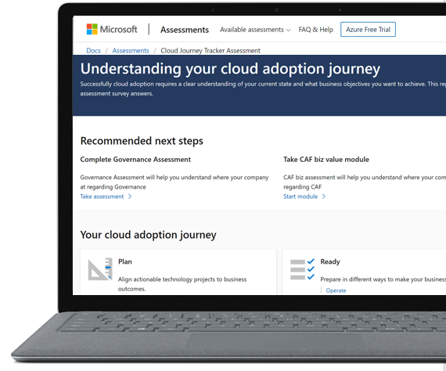
Assessment
Cloud Journey Tracker
Navigate to the most relevant adoption content efficiently, and detect early adoption blockers
aka.ms/adopt/journeytracker

Slide 23
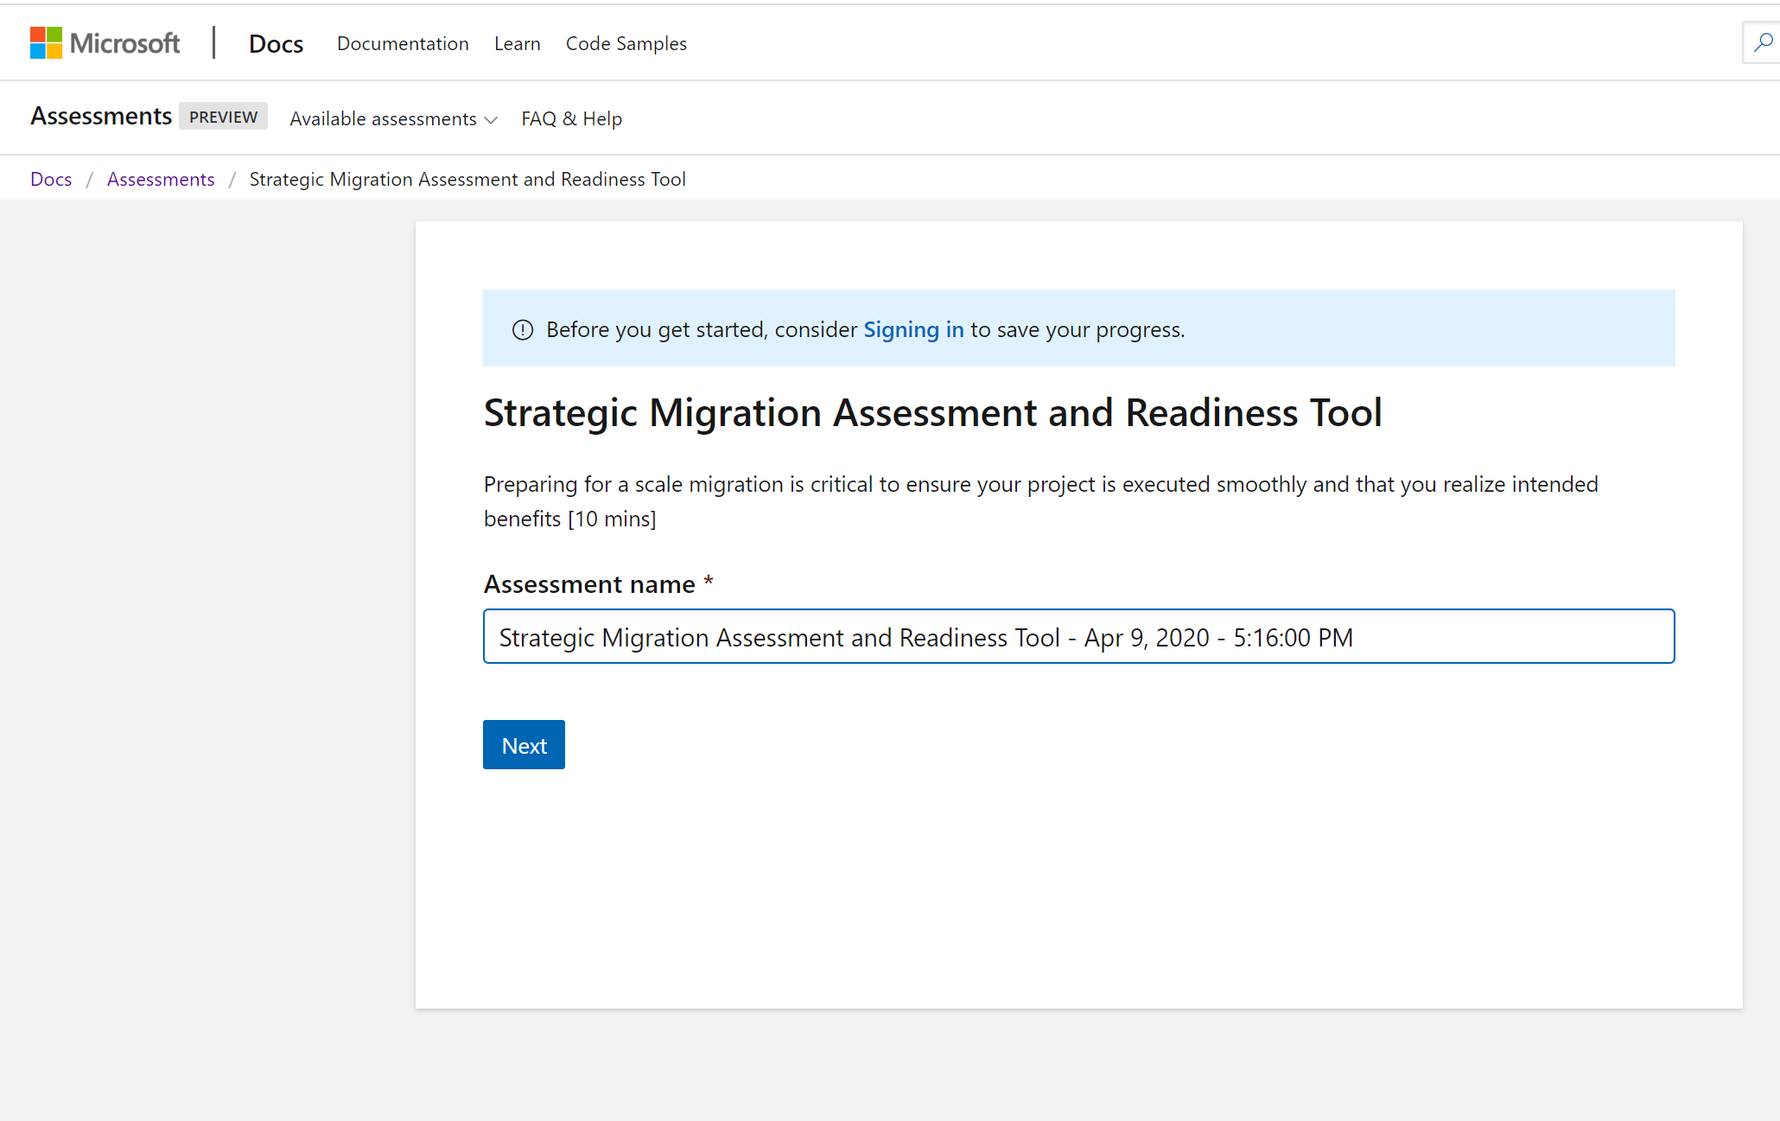
Assessment
SMART
Strategic migration assessment and readiness tool
Prepare for a scale migration
aka.ms/smarttool
Hold for copy- and needs graphic update

Slide 24
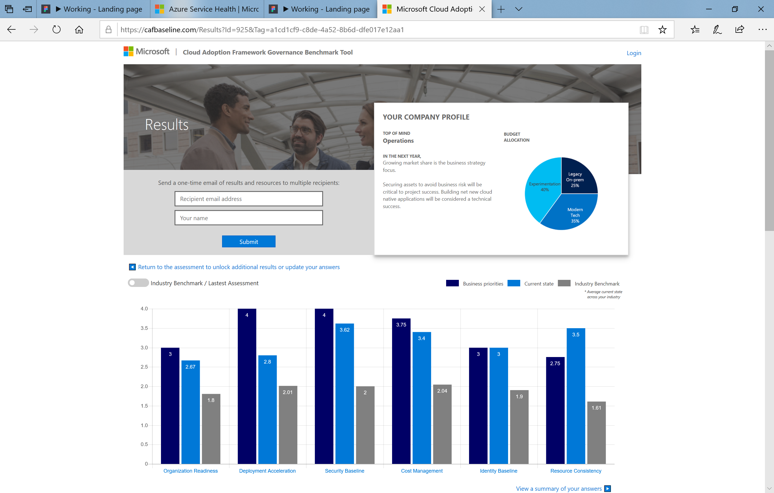
Assessment
Governance Benchmark
Understand your current state and prepare for your cloud journey
aka.ms/adopt/gov/assess

Slide 25
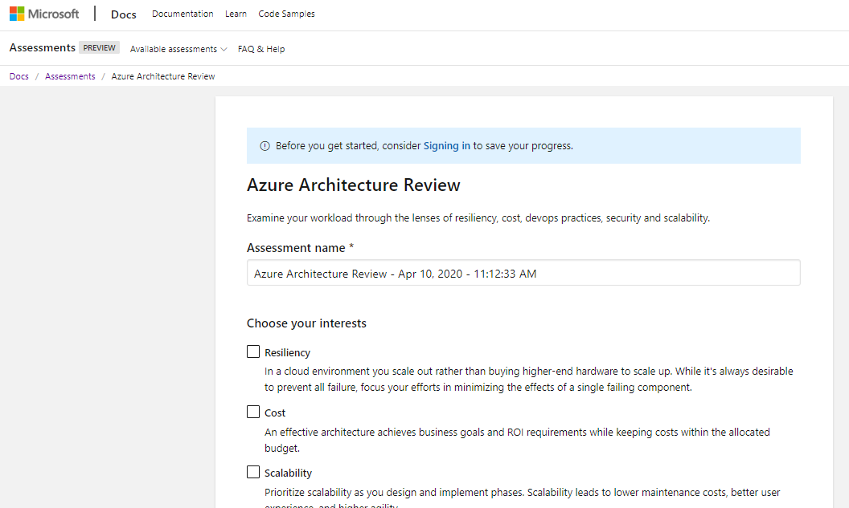
Assessment
Azure Architecture Review
Examine your workloads through the lenses of resiliency, cost, devops practices, security and scalability.
aka.ms/adopt/architecturereview

Slide 26
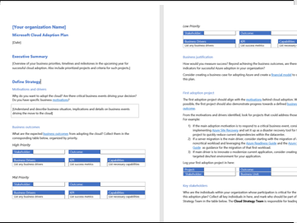
Template
Cloud Adoption Plan Template
Align technical efforts with business outcomes.
Cloud adoption plan template

Slide 27
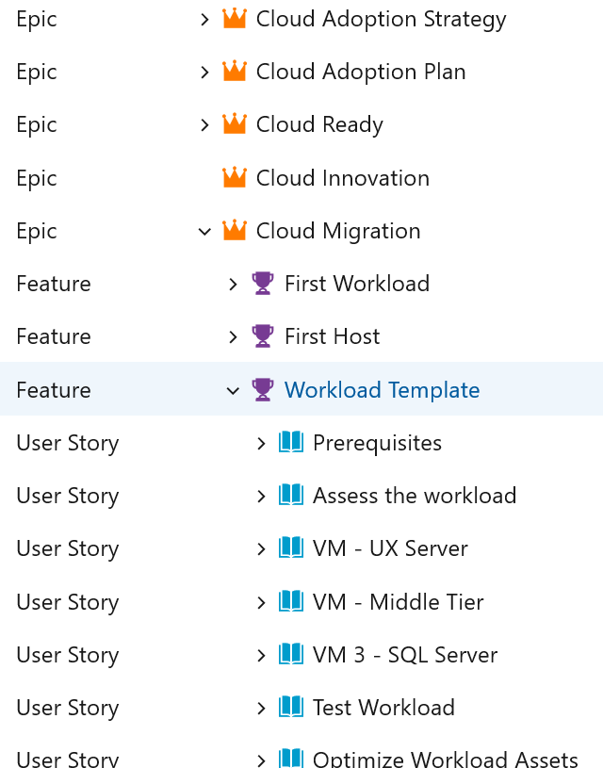
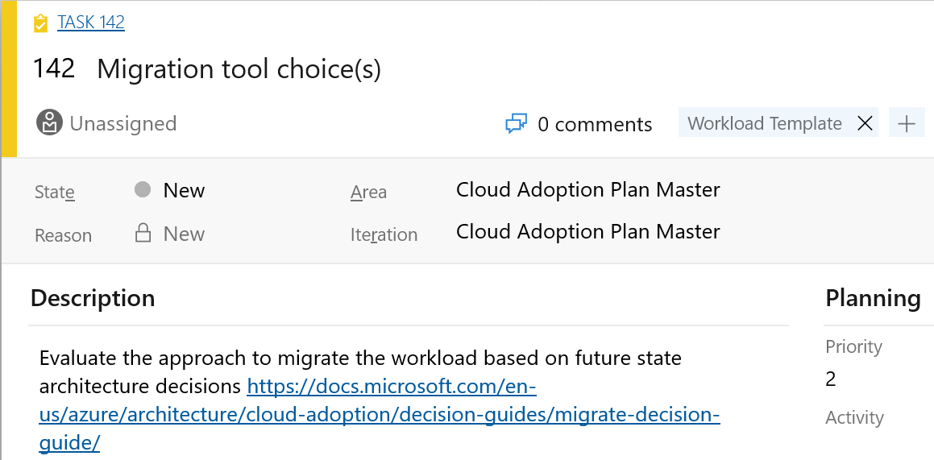
Tool
Azure DevOps Plan Generator
Leverage Azure DevOps to log and track your cloud adoption plan
Cloud adoption plan + Azure DevOps

Slide 28
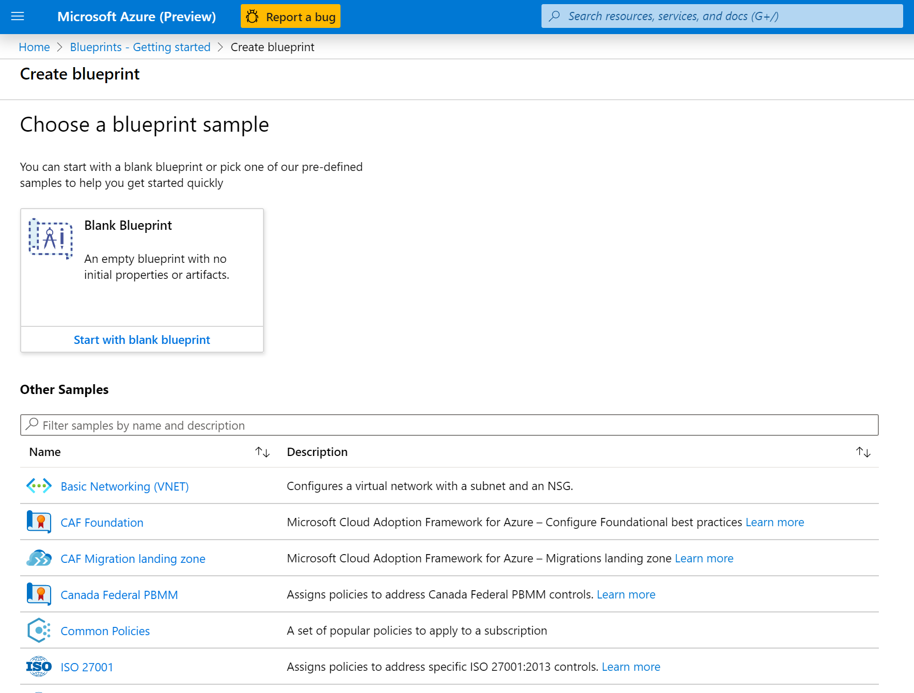
Tool
Landing zones
Host your workloads, pre-provisioned through code. Including foundational capabilities using defined set of cloud services and best practices.
Foundation blueprint
Migration landing zone blueprint
Terraform landing zone blueprint

Slide 29
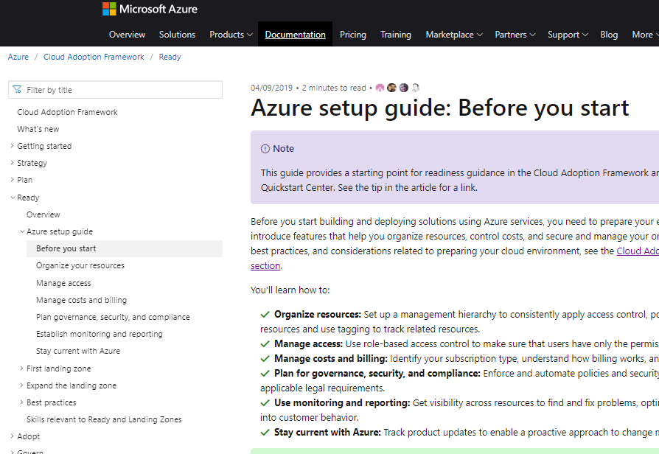
Resource
Azure Setup Guide
Step-by-step guidance to help admins plan, set up, and secure Azure for your organization
aka.ms/adopt/setupguide

Slide 30
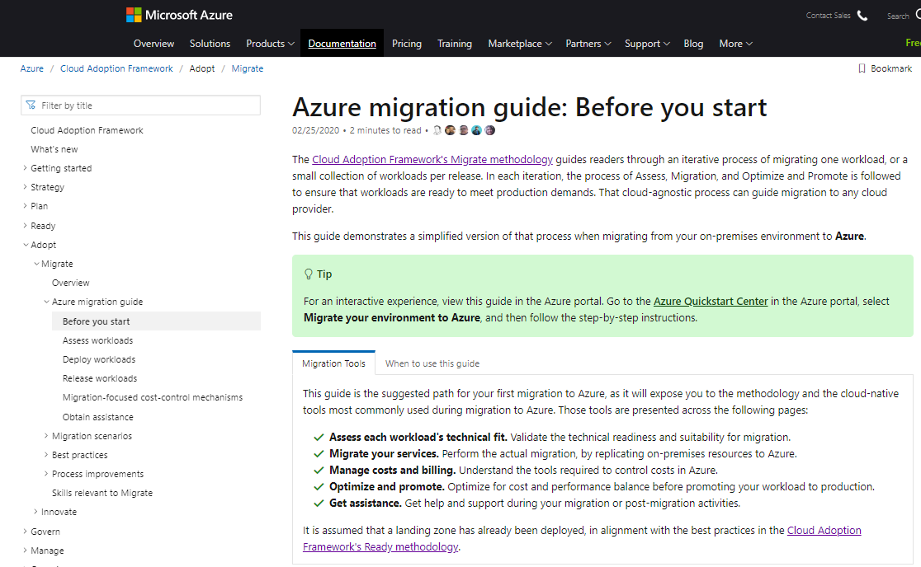
Resource
Azure Migration Guide
Step-by-step guidance to help assess your current environment, prepare for migration, and make the shift to Azure
aka.ms/adopt/migrationguide

Slide 31
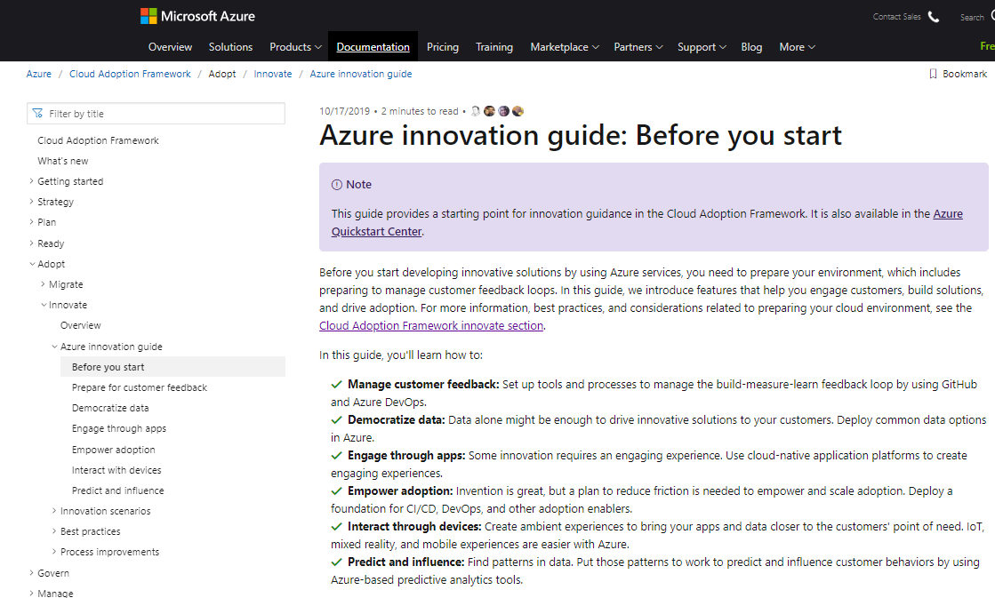
Resource
Azure Innovation Guide
Step-by-step guidance to help build innovative solutions leveraging Azure platform capabilities
aka.ms/adopt/innovationguide

Slide 32
Accelerate your digital transformation journey with Microsoft Cloud Adoption Framework for Azure
Find a partner
https://aka.ms/adopt/ findapartner
Take an assessment
https://aka.ms/adopt/ assess
Read Documentation
https://aka.ms/adopt/ overview
Find consulting services
Microsoft Consulting Services
Complete learning module
Microsoft Learn

